Slide 1
Embedded Operating Systems
3.4 Mutual Exclusion
Shripad V Deshpande

Slide 2
Task Synchronization
In multitasking environment, multiple processes run concurrently and share the system resources like memory, variables, I/Os. [An Example of Train A, B.]
If a task tries to write to a memory location which is read by another task, it will result into unexpected operations.
The act of making processes aware of the access of shared resources by each process to avoid conflicts is known as “Task Synchronization”.
If Task Synchronization is not there, several issues will come into picture.
These issues are (1) Racing (2) Deadlocks

Slide 3
Racing
To understand the issues, you must be aware of atomic/non-atomic operations.
An atomic operation is one that can be performed in a single step, without the possibility of interruption.
For example an operation “Var++” in a C language is a non-atomic operation, since it requires memory read, increment and memory write kind of tasks.
Between Read and Write of variable “Var”, task switching can occur and the new task may access the same variable! – Undesirable results will be there!
This situation is referred as “Racing”.
Racing is the situation in which multiple processes compete (race) each other to access and manipulate shared data concurrently!

Slide 4
Solution for race condition
The simplest solution : Disable the interrupts during the usage of a variable.
Interrupt disabled -> No task switching -> No corruption of data by other tasks.
But … this solution may increase the interrupt latency. Hence not desirable at all.

Slide 5
Mutual Exclusion
only one process can hold a resource at a time. Critical section of code also under this category.
semaphore is a technique for implementation of mutual exclusion for the shared resources. It’s a flag which is a system resource.
The process which wants to access the shared resource can first acquire this system object to indicate all the other processes that the shared resource is currently acquired by it!

Slide 6
Semaphore as an Event - Signaling or Notifying Variable
Let a binary Boolean variable ‘s’, represents the Semaphore. This Semaphore is used by OS for signaling or notifying of a certain action and for notifying the acceptance of the notice or signal.
Let ‘s’ increments from 0 to 1 for signaling or notifying occurrence of an event from a section of codes in a task or thread. When the event is taken note by a section in another task waiting for that event, ‘s’ decrements from 1 to 0 and the waiting task can start it execution.
When any task wants to utilized shared resource, a semaphore associated with it must be examined first. If semaphore is ‘1’, it indicates that the resource is free, else the resource is occupied!

Slide 7
Types of Semaphores
The semaphore is of two types
(1) Binary Semaphore (also known as mutex)
(2) Counting Semaphore
Semaphore checking and setting must be done through atomic operation!!!
The instruction used should not be interruptible and block the system bus for the entire transaction so that no other process can be granted access between read and write accesses!!!
Swap and Exchange instructions are given by architectures for this purpose!

Slide 8
Semaphore Operations
Before accessing the semaphore, each task say for example task A needs to use OS function xSemaphoreTake().
If Semaphore = 0, it indicates that the Semaphore (and hence the resource synchronized by the Semaphore) is already occupied and hence this task will have to wait until the Semaphore is released!
If semaphore = 1, then as a part of this function, OS returns the semaphore as accepted by decrementing the semaphore from 1 to 0. Now Task A gets the access to a resource.

Slide 9
Semaphore Operations (contd.)
Task A after completion of access to a resource notifies to the OS about releasing the semaphore using an OS function xSemaphoreGive() which releases the semaphore by incrementing it to from 0 to 1. This is very essential otherwise other tasks will be in waiting state for the Semaphore all the time.
Take – Accept Semaphore & Decremented from 1 to 0 (to notify OS about busy state of Semaphore), if Semaphore is occupied wait upon.
Give – Released – Incremented from 0 to 1

Slide 10
Example
void task1(void *q)
{
while(1) {
xSemaphoreTake(binarysem,portMAX_DELAY);
sendsserial("Task1 functioning");
sendsserial("\r\n");
xSemaphoreGive(binarysem);
y++;
vTaskDelay(5);
}
}

Slide 11
Priority Inversion
Priority inversion is the problem getting introduced due to lock based Task Synchronization implemented with Semaphore.
It is a condition in which a high priority task needs to wait for a low priority task to release a resource which is shared between high and low priority tasks, and a medium priority task not requiring shared resource continue its execution by preempting the low priority task!

Slide 12
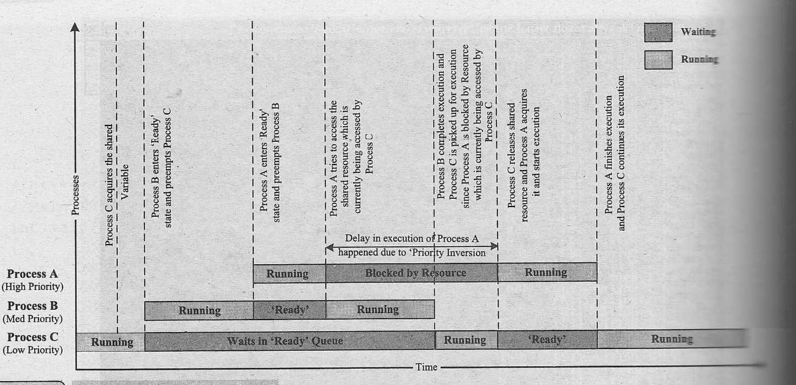
Process A preempts Process B and tries to acquire shared variable using Semaphore & then blocked immediately
Process C acquires shared variable using Semaphore
Process B preempts Process C

Slide 13
The highest priority task A has to wait till lower priority task C gets a chance to execute and release the semaphore.
This produces unwanted delay in the execution of high priority task.
Boosting the priority of the low priority task to that of the high priority task (only for that duration!) which request for the resource currently occupied by the low priority task is called Priority Inheritance.
What is starvation?
Starvation getting introduced due to Priority inversion can be solved by “Priority Inheritance”.

Slide 14
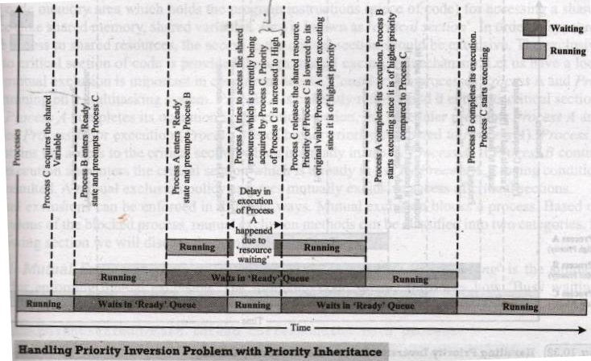
Priority Inheritance
As soon as Process A requests for Semaphore which is occupied by a low priority process C, RTOS will exchange the priority of Process C with Process A. Hence immediately Process C will execute and finish the job with Semaphore, so that Process A will not have to wait longer and get access of Semaphore once Process C has done its job.

Slide 15
Using semaphore in Linux
To use semaphores in Linux we use pthread functions.
Include semaphore.h
Second Compile the code by linking with options
-lpthread –lrt

Slide 16
semaphore functions in Linux
To declare a semaphore, the data type is sem_t.
A semaphore is initialised by using sem_init(for processes or threads) or sem_open (for IPC).
sem_init(sem_t *sem, int pshared, unsigned int value);
sem : Specifies the semaphore to be initialized.
pshared : This argument specifies whether or not the newly initialized semaphore is shared between processes or between threads. A non-zero value means the semaphore is shared between processes and a value of zero means it is shared between threads.
value : Specifies the value to assign to the newly initialized semaphore.

Slide 17
semaphore functions in Linux
To lock a semaphore or wait we can use the sem_wait function:
int sem_wait(sem_t *sem);
To release or signal a semaphore, we use the sem_post function:
int sem_post(sem_t *sem);
To destroy a semaphore, we can use sem_destroy.
sem_destroy(sem_t *sem);

Slide 18
Sample code
// C program to demonstrate working of Semaphores
#include <stdio.h>
#include <pthread.h>
#include <semaphore.h>
#include <unistd.h>
sem_t mutex;
void* thread(void* arg)
{
//wait
sem_wait(&mutex);
printf("\nEntered..\n");
//critical section
sleep(4);
//signal
printf("\nJust Exiting...\n");
sem_post(&mutex);
}
int main()
{
sem_init(&mutex, 0, 1);
pthread_t t1,t2;
pthread_create(&t1,NULL,thread,NULL);
sleep(2);
pthread_create(&t2,NULL,thread,NULL);
pthread_join(t1,NULL);
pthread_join(t2,NULL);
sem_destroy(&mutex);
return 0;
}

Slide 19
Code explanation
2 threads are being created, one 2 seconds after the first one. But the first thread will sleep for 4 seconds after acquiring the lock. Thus the second thread will not enter immediately after it is called, it will enter 4 – 2 = 2 secs after it is called.
So the output is:
Entered..
Just Exiting...
Entered..
Just Exiting...

Slide 20
Deadlock
Deadlock is the condition in which a process is waiting for resource held by another process which is waiting for a resource held by the first process.
Process A holds a resource ‘x’ and it wants a resource ‘y’ held by Process B. Process B is holding resource ‘y’ and it wants the resource ‘x’ which is currently held by Process A!
Process A
Process B
Holds
Wants
x
Wants
y
Holds

Slide 21
Conditions for deadlock
Mutual Exclusion
some resources can only be accessed by one process at a time.
Hold and Wait
a process is holding at least one resource and is waiting to acquire additional resources.
No Pre-emption
resources cannot be forcibly taken away from a process.
Circular Wait
each process waits for a resource that another process holds in the set, creating a circular dependency
Deadlock Avoidance – Break at least one condition

Slide 22
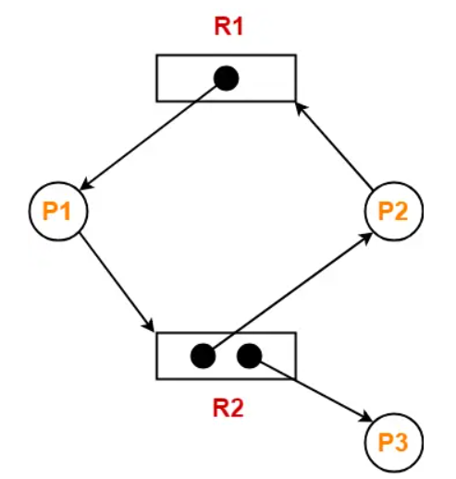
Methods for Deadlock Detection
Resource-allocation graph
Graphical representation of the resources and processes in the system.
nodes representing processes and resources and edges representing resource requests and allocations.
For single-instanced resources, the occurrence of a cycle indicates a deadlock.
For multiple instance resources, cycle may or may not indicate deadlock. (No cycle-> definitely no deadlock, Cycle-> may or may not be deadlock e.g. figure)
 | Allocation |  | Need
 | R1 | R2 | R1 | R2
Process P1 | 1 | 0 | 0 | 1
Process P2 | 0 | 1 | 1 | 0
Process P3 | 0 | 1 | 0 | 0

Slide 23
Deadlock Avoidance by Banker’s Algorithm
Ensures that a state is safe by simulating the execution of processes and checking if they can complete their execution without entering a deadlock state.
If a safe state cannot be reached, allocation is stopped and deadlock avoided.
The algorithm works on four data structures –
Available[R1] = no of instances of R1 presently available
Max[P1][R1] = max no. of instances of R1 that P1 requires
Allocation[P1][R1] = no of R1s presently allocated to P1
Need[P1][R1] = no of R1s still needed by P1)
For every resource request the algorithm is run to check if this allocation will lead to deadlock. If yes, then the allocation is canceled.

Slide 24
Deadlock Recovery
Process Termination
May result in data loss or inconsistency, as the terminated processes may have made partial progress before the deadlock occurred.
Selection of a process for termination is based on - process's priority, the progress made by the process, and the resources consumed by the process.
Resource Preemption
forcibly taking resources from one or more processes involved in the deadlock.
resource preemption and system roll back could be complex.
selection of which process to pre-empt involves carefull consideration to minimize the impact
Deadlock recovery strategies may result in performance degradation or data loss.

